Slide 1
INTERNSHIP PROGRAMME PRESENTATION (MSTY)
TRAINING PROGRESS MONITORING
Prepared By : ALVIN ANAK SAMAIL

Slide 2
TABLE OF CONTENT
No | Description | Page
1 | Objectives | 1
2 | List of Task | 2
3 | Main Contributions | 3
4 | Achievement | 4
5 | Challenges & Solution | 5
6 | Strong Point & Weak Point | 6
7 | Summary | 7

Slide 3
OBJECTIVES
The Industrial Training is aiming for helping student to increase and overcome their self confident on their abilities and skill in the working area.
The objective of industrial training is to give a change for student to recognize the real working environment and to increase the ability of graduates to work.
The student are been train to enhance their own skill to apply their studies field into working environment and improve their abilities in many field in term of disciplines, communication, skill, problem solving, understanding.

Slide 4
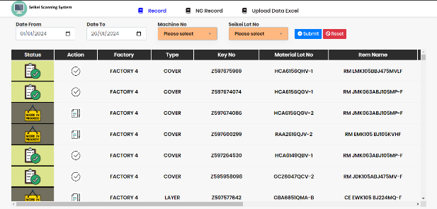
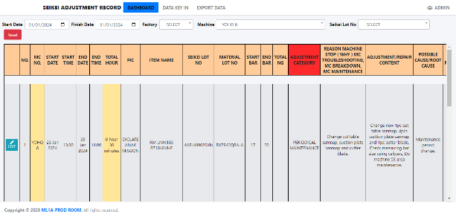
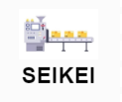
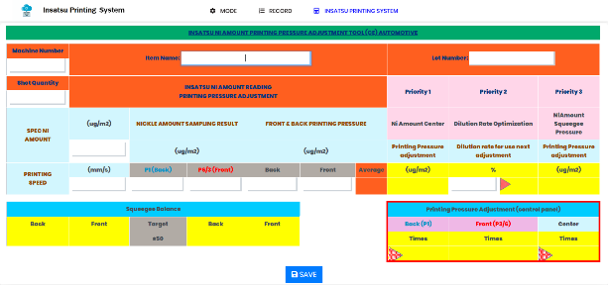
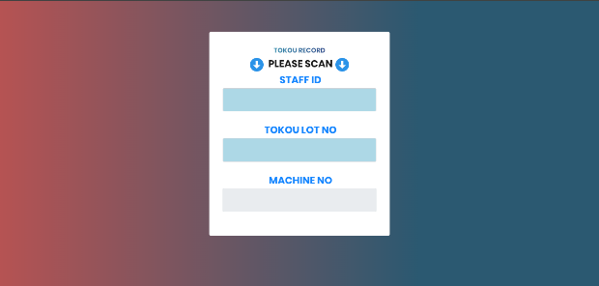
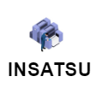

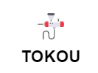
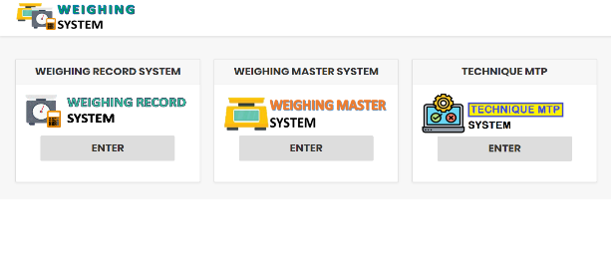

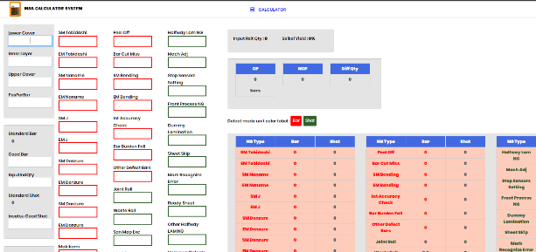

LIST OF TASK
Seikei Adjustment Record System
Seikei Scanning System
Insatsu Printing System
Weighing Record System
MSS Calculator System
Haigou Tokou Scanning System

Slide 5
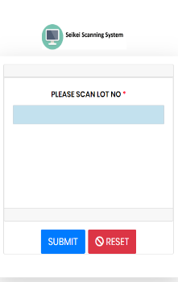
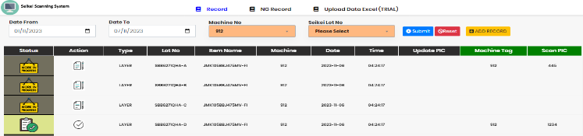
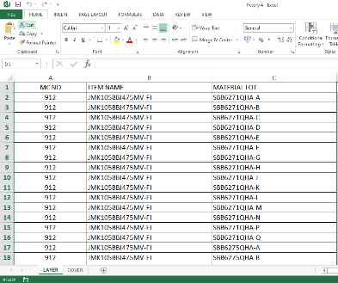
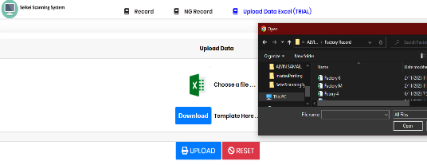
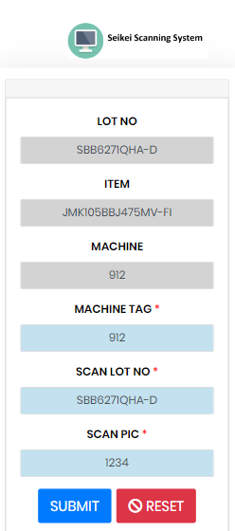



Seikei Scanning System
Design the UI data viewer :
Data insertion into table :
Data record for machine process :
List of Data Record
Tablet Scanner
Read
Create
List of Data Record
Web System Data Converter
Excel Data Fomat
Create
Read
Update
Start
Machine Process
Tablet Scanner
Data Viewer & Scanner
Data Evaluation

Slide 6
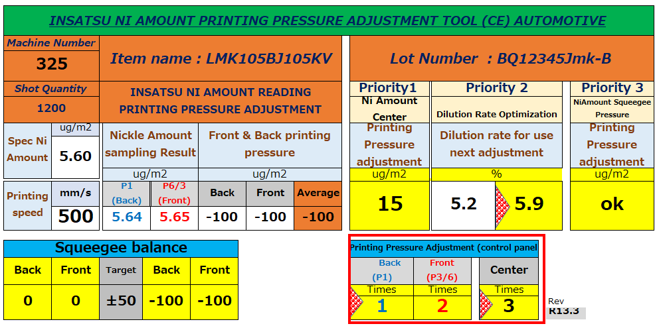
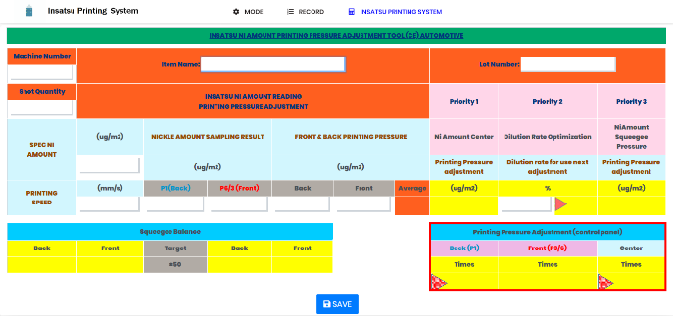


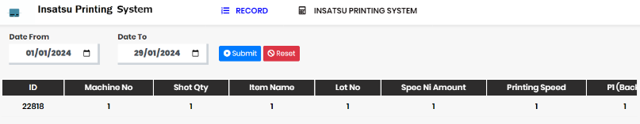
Insatsu Pressure Printing System
Sketch and Develop the UI :
Develop the calculation function for the web system :
Storing the calculation data inside the database :
Create
Excel System UI
Web System UI
Computer
Create
Update
Calculator
Web Calculation System
Create
List of Data Calculation Record
Web Calculation System

Slide 7
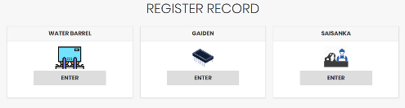
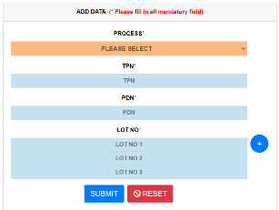

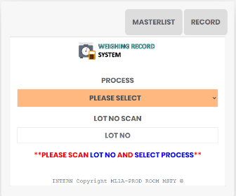

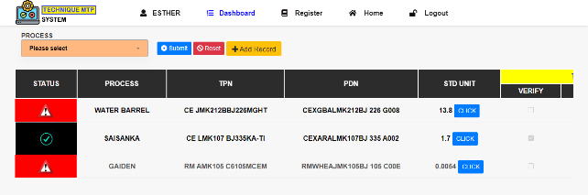


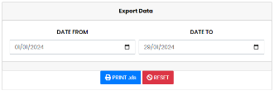

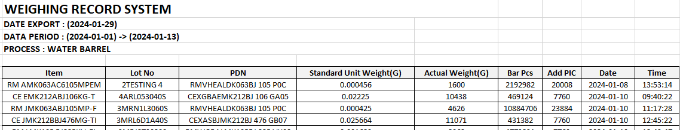
Weighing System
Standardize the UI of the system :
Adding new data record view :
Data record in web system conversion into excel :
Main Menu
Add Record for MTP Lot
MP Lot
Create
Create
Lot No Evaluation
MTP Lot
Data Listing
Read
Create
MS Excel
Excel Data Format Record
Data Filter Record

Slide 8
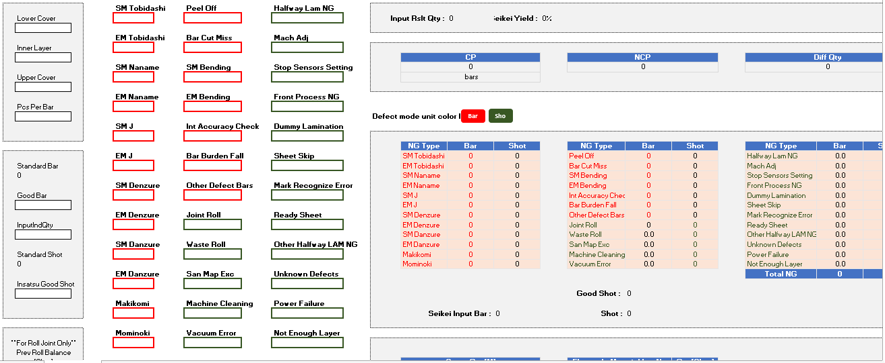
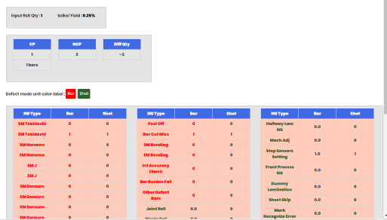
MSS Calculator System
Sketch and develop the UI :
Develop the calculation function for the web :
Create
Excel System UI
Web System UI
Create
Update
Computer
Calculator
Web Calculation System

Slide 9
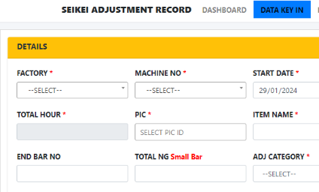
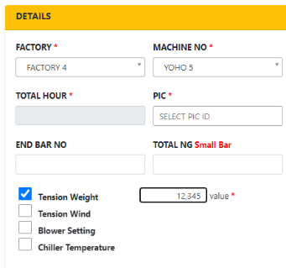
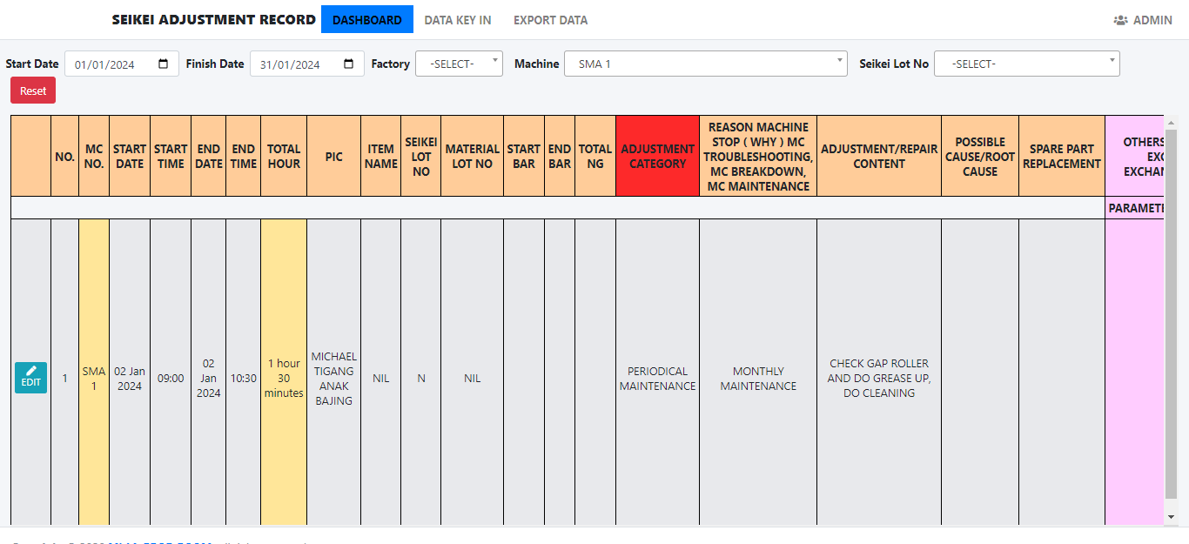
Seikei Adjustment Record System
Create the data insertion for new machine :
Update the filter for the new machine :
Create
Options
Data Entry
Data Record Filter
Read
Data Filtered List

Slide 10
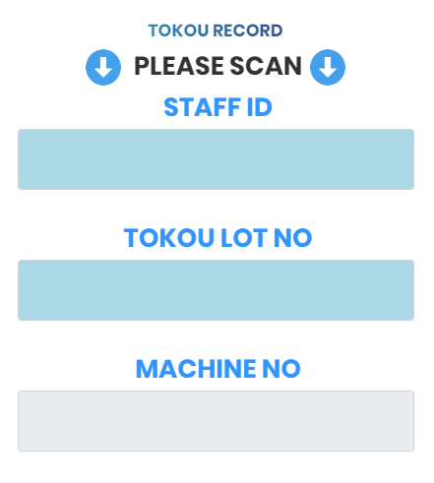
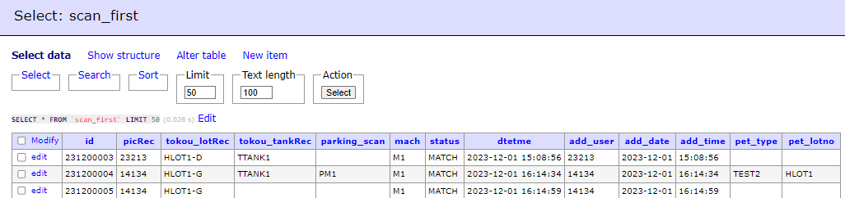
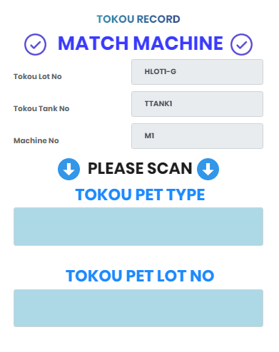
Haigou~Tokou Scanning System
Proposed the flow of data relocation for the tablet :
Creating Data Validation for the Scanner :
Create
Read
Server Database
Tablet UI
Create
Start
Machine Process
Data Evaluation UI
Tablet UI

Slide 11




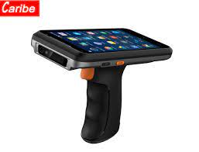
MAIN CONTRIBUTION
Seikei Scanning System:
Insatsu Printing System:
Weighing System:
Haigou~Tokou Scanning System:
More Faster
Data
Database
System
User Friendly and Data Record
System
Calculation
MTP
&
MP
New Lot System Added into the System
System
Database
More Manageable
Scanner
Database

Slide 12
ARCHIEVEMENT
Able to finish 6 project & task assign by company.
Learn how to install a system inside the checkroid in process.
Understanding the process of making Multi-Layer Ceramic Capacitor (MLCC).
Discipline in workplace and other places.
Able to manage work well in completing task when due data was given.
Design a project with attractive UI for the process system usage.
Learn to adapt with the system functionalities and flow in term of coding and process.

Slide 13
ARCHIEVEMENT (CON)
Challenge :
I cannot access the internet directly into my laptop.
I cannot access process with my own ID to learn the system by myself.
Facing a limited source gain to construct the system.
Unclear explanation during the orientation.
Hard to approach the system functionality.
Hard to making the team leader and operator understanding the new system.
Hard to refer the ownership of the system and maintain the system.
Hard to handle crowded database of the company.
Solution :
Use mobile phone to access the internet for the resources finding and learning.
Enter the process using the OJT id and my SV id to ensure that I learn the system well and able to understanding the system.
I have to learn by myself at home and bring the concept back to the working places also known as company office to conduct the system.
Learn the process by the system flow and how the data flow in the server and how its stored.
Taking time to break the system part-by-part to know which functionality belong to the current system until it reach the core system function.
Learn and convert the system that can adaptive with the operator understanding and create a machine learning to control the system data flow and stored inside the process.
Learning the concept of the system by myself and adapt with the system by my own.
Break the table and problem by pieces until the problem resolve.

Slide 14
ARCHIEVEMENT (CON)
Strong Point (MSTY):
Positive customer perceptions.
Dedicated to continuously produce the production of MLCC.
Manageable time management in daily work.
Determination of planning every work to be accomplish.
Efficient time management.
Organized department team in company.
Weak Point (MSTY):
Outdated technology infrastructure.
Using the traditional method to securing the data policy.
Unable to stored big data and lack of technology.
Does not accept the employee suggestion and also hard to deal with management.
Long-Term planning for the product to produce the new one.
Short-Sighted to the current security where unable to productive in the system.
To strict in handling work and dependencies of the above level of management.

Slide 15
SUMMARY
In summary, after 6 month of internship training at Taiyo Yuden (Sarawak) Sdn. Bhd. (MSTY) has gain on how the industry of MLCC in the factory area. The task given are open the student opportunity to learn and show the skill in the company where how the student will adapt the surrounding of office environment. The company had give the needed accessories and tool to the student for completing the task given and that is very meaningful and very comfort in term of CSR and also other related things. At the end of the training will looking forward to expand my skill in the company and improve my certain skill. Last but not least leaving grateful thanks to my supervisor from Taiyo Yuden Miss Esther and also other supervisor that has guide me through the training.

